Slide 1
Chapter 20 Lists, Stacks, Queues, and Priority Queues

Slide 2
Objectives
To explore the relationship between interfaces and classes in the Java Collections Framework hierarchy (§20.2).
To use the common methods defined in the Collection interface for operating collections (§20.2).
To use the Iterator interface to traverse the elements in a collection (§20.3).
To use a foreach loop to traverse the elements in a collection (§20.3).
To use a forEach method to perform an action on each element in a collection (§20.4).
To explore how and when to use ArrayList or LinkedList to store a list of elements (§20.5).
To compare elements using the Comparable interface and the Comparator interface (§20.6).
To use the static utility methods in the Collections class for sorting, searching, shuffling lists, and finding the largest and smallest element in collections (§20.7).
To develop a multiple bouncing balls application using ArrayList (§20.8).
To distinguish between Vector and ArrayList and to use the Stack class for creating stacks (§20.9).
To explore the relationships among Collection, Queue, LinkedList, and PriorityQueue and to create priority queues using the PriorityQueue class (§20.10).
To use stacks to write a program to evaluate expressions (§20.11).

Slide 3
What is Data Structure?
A data structure is a collection of data organized in some fashion.
The structure not only stores data, but also supports operations for accessing and manipulating the data.
The right data structure will help (or hurt) the efficiency of your program

Slide 4
Java Collection Framework hierarchy
A collection is a container object that holds a group of objects, often referred to as elements. The Java Collections Framework supports two types of collections:
One, for storing a collection , is simply called collection.
The other, for storing key/value pairs, is called a map.

Slide 5
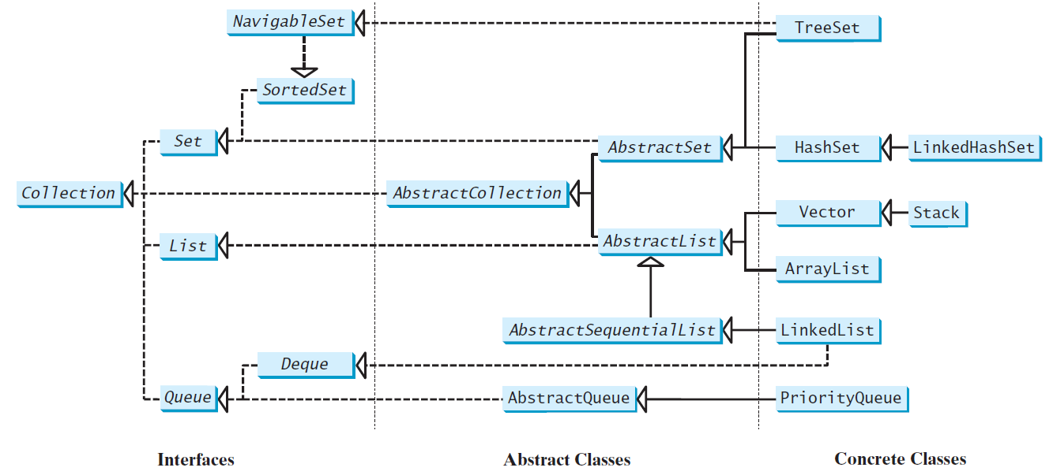
Java Collection Framework hierarchy, cont.
Set and List are subinterfaces of Collection.

Slide 6
The Collection Interface
The Collection interface is for manipulating a collection of objects.
UML Diagram
TestCollection

Slide 7
Collections Interface
The Collection interface defines the common operations for data structures (stacks, queues, lists, priority queues, lists, sets)
There is also a Collections class that has static methods inherited by all the subclasses
  Sort, search, min/max find, reverse, etc. (They return null if it’s empty)
Lists store an ordered (not sorted) collection of elements (duplicates ok)
Sets store a group of nonduplicate elements
Collections are sometimes called containers
They can store, manipulate, retrieve & aggregate data
Some containers just have a collection of elements
Others, called maps, store key/value pairs
Collections interface has add, remove & query methods (size, isEmpty, contains…)
toArray() will return an array of the elements
To convert from array to a list use Arrays.asList()

Slide 8
Collections Example
import java.util.Arrays;
import java.util.Collections;
import java.util.List;
public class CollectionsExample
{
public static void main(String[] args) {
Integer [ ] array1 = {31,1,82,3,105,89,13,21,34,55};
List<Integer> list1 = Arrays.asList(array1);
System.out.println(list1);
Collections.sort(list1);
System.out.println(list1);
System.out.println("position of 21: "+ Collections.binarySearch(list1, 21));
}
}
Notes:
L

Slide 9
Collections Method
Practice using contains, removeAll, & retainAll

Slide 10
Iterators
An iterator is an object that will let you go through the elements in some type of collection.
The Collection interface extends the Iterator interface
It has tools to go through the data structure & hides the details of how data is stored and how Java gets to each element
Iterators has an iterator() method and a foreach() method
The iterator() method returns an Iterator object
The Iterator contains hasNext(), next(), remove() and other methods
There is also another interface called ListIterator for list collections
ListIterator adds methods to go through list backwards: previous(), hasPrevious(), previousIndex(),….
TestIterator

Slide 11
Iterators
import java.util.*;
public class TestIterator
{
  public static void main(String[] args)
  {
    Collection<String> collection = new ArrayList<>();
    collection.add("New York");
    collection.add("Atlanta");
    collection.add("Dallas");
    collection.add("Madison");
    Iterator<String> iterator1 = collection.iterator();
    while (iterator1.hasNext())
    System.out.print(iterator1.next().toUpperCase() + " ");
    System.out.println();
  }
}

Slide 12
Using the forEach Method
Java 8 added a new forEach method in the Iterable interface. It functions like a foreach loop.
TestForEach

Slide 13
Using the forEach Method
import java.util.*;
public class TestForEach
{
  public static void main(String[] args)
  {
    Collection<String> collection = new ArrayList<>();
    collection.add("New York");
    collection.add("Atlanta");
    collection.add("Dallas");
    collection.add("Madison");
    collection.forEach(e -> System.out.print(e.toUpperCase() + " "));
  }
}
TestForEach

Slide 14
The List Interface
A list stores elements in a sequential order and allows the user to specify where the element is stored.
The user can access the elements by index.

Slide 15
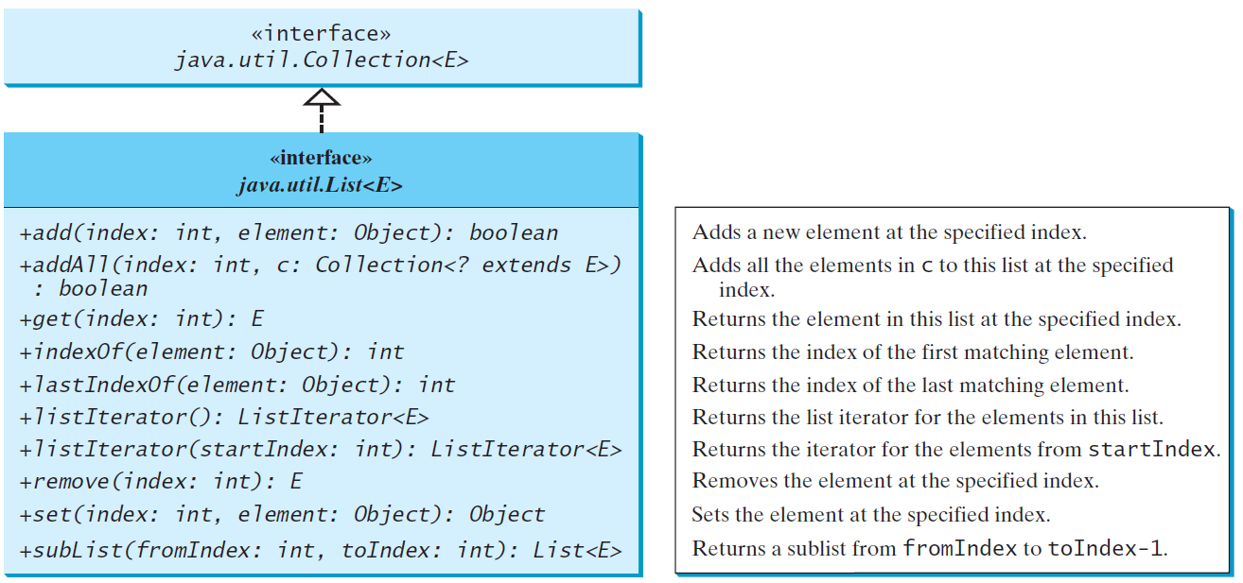
The List Interface, cont.

Slide 16
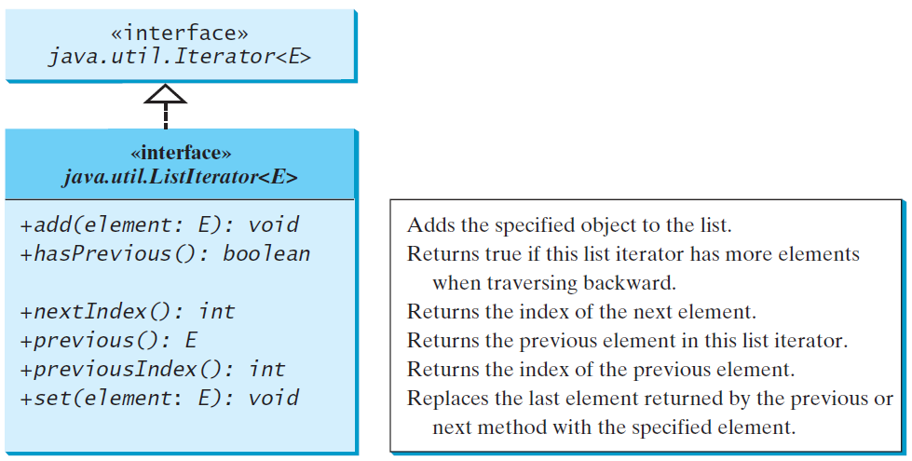
The List Iterator

Slide 17
ListIterators
Practice
  Write a program to create an ArrayList and fill it with 10 random numbers.
  Print the original list
  Use a ListIterator to go through the list backward and print each element

Slide 18
ListIterators
Random rand = new Random();
ArrayList<Integer> sList = new ArrayList<>();
for (int i = 0; i < 10; i++)
sList.add(rand.nextInt(101));
sList.forEach(m->System.out.print(m + " "));
System.out.println();
ListIterator<Integer> it = sList.listIterator( sList.size() );
while(it.hasPrevious())
{
System.out.print(it.previous() + " ");
}
System.out.println();

Slide 19
ArrayList and LinkedList
The ArrayList class and the LinkedList class are concrete implementations of the List interface.
Which of the two classes you use depends on your specific needs.
  If you need to support random access through an index without inserting or removing elements from any place other than the end, ArrayList offers the most efficient collection.
  If, however, your application requires the insertion or deletion of elements from the beginning of the list, you should choose LinkedList.
A list can grow or shrink dynamically.
An array is fixed once it is created. If your application does not require insertion or deletion of elements, the most efficient data structure is the array.
Notes:
ArrayList kiểu access random như arr[index]
Còn LinkedList thì access theo thứ tự từ đầu tới cuối

Slide 20
ArrayLists
ArrayLists let you get fast access to any element using indexes.
Can also add/remove elements at given index
Most used data structure
Don’t have to give an initial size. Can grow and shrink as needed.
Can add nulls to an ArrayList
Duplicates are allowed
The trimTo() method can reduce the size of the ArrayList to only fit the number of elements there

Slide 21
ArrayLists
ArrayLists use internal arrays for storage, which makes random access fast
Can be time consuming to add elements in the middle because Java would have to move everything after the inserted element down one in the array where it’s keeping the values. (Also slow to delete items in middle)
Waste space if array not full. Need to be resized when they reach capacity (Done behind the scenes by Java but needs work and overhead.)

Slide 22
java.util.ArrayList

Slide 23
ArrayList Example
import java.util.*;
public class TestArrayList
{
  public static void main(String[] args)
  {
    ArrayList<String> aList = new ArrayList<>();
    aList.add(“Pluto”);
    aList.add(“Earth”);
    aList.add(“Jupiter”);
    System.out.println("Original List: " + aList);
    aList.add(0, “Venus”);
    aList.add(3, “Saturn”);
    System.out.println(“Updated List: " + aList);
    System.out.println(aList.get(2));
  }
}
Output
Original List: [Pluto, Earth, Jupiter]
Updated List: [Venus, Pluto, Earth, Saturn, Jupiter]
Earth

Slide 24
ArrayList Example
Write a method that receives an ArrayList of Strings and creates a second cloned list from it.
Sort the cloned list
Use the forEach function to print both lists

Slide 25
ArrayList Example
ArrayList<String> sList = new ArrayList<>();
ArrayList<String> secondList = new ArrayList<>();
File inputfile = new File("Colleges.txt");
Scanner infile = new Scanner(inputfile);
while (infile.hasNext())
{
String s = infile.nextLine();
sList.add(s);
}
System.out.print("First List: ");
sList.forEach(e->System.out.print(" " + e));
System.out.println();
secondList = (ArrayList)sList.clone();
Collections.sort(secondList);
System.out.print("Second List: ");
secondList.forEach(e->System.out.print(" " + e));
System.out.println();

Slide 26
LinkedLists
GroceryList
milk
bread
eggs
butter
cookies
Null
LinkedLists are collections of elements that are joined together with links (pointers) to each other. (Before Java 7, you had to create them yourself.)
Actually, uses a doubly linked list – which means that each node has a pointer to the next node and a pointer to the previous node
So, you can go either direction – forward or backward
Use a ListIterator object to travel backwards
Last item’s pointer points to Null to show that it’s the end of the list
Good if you’ll be adding elements to middle or end of list because it doesn’t take as much overhead as it does to do that with an ArrayList
Many data structures are built using linked lists

Slide 27
LinkedList Pros & Cons
GroceryList
milk
bread
eggs
butter
cookies
Null
LinkedLists allow for easy insertion and deletion operations (just reassign pointers in nodes before/after them)
Very efficient to add/delete items (in terms of Java work/overhead)
Elements in a LinkedList have to be read sequentially – you can’t just jump to the node in the middle that you want (like cassette tapes)
Elements are not stored sequentially in memory (unlike ArrayLists)
Slower iterations and extra memory overhead are required to keep track of the pointer to the next element in the list

Slide 28
java.util.LinkedList

Slide 29
LinkedList Example
Output
[Alabama, Alaska, Arizona, Arkansas, Pennsylvania, California, Colorado, Connecticut]
Last state in my list: Connecticut
Connecticut
Colorado
California
Pennsylvania
Arkansas
Arizona
Alaska
Alabama
import java.util.LinkedList;
import java.util.ListIterator;
public class LinkedListExample
{
  public static void main(String[] args)
  {
  LinkedList<String> states = new LinkedList<>();
  states.add("Alaska");
  states.add("Arizona");
  states.add("Arkansas");
  states.add("Pennsylvania");
  states.add("California");
  states.add("Colorado");
  states.add("Connecticut");
  states.addFirst("Alabama");
  System.out.println(states);
  System.out.println(“\n Last state in my list: "+states.getLast());
  ListIterator iterator = states.listIterator(states.size());
  while(iterator.hasPrevious())
    System.out.println(iterator.previous());
  }
}

Slide 30
Example: Using ArrayList and LinkedList
This example creates an array list filled with numbers and inserts new elements into the specified location in the list. The example also creates a linked list from the array list, inserts and removes the elements from the list. Finally, the example traverses the list forward and backward.
TestArrayAndLinkedList

Slide 31
Example: Using ArrayList and LinkedList
import java.util.*;
public class TestArrayAndLinkedList
{
public static void main(String[] args)
{
    List<Integer> arrayList = new ArrayList<>();
    arrayList.add(1); // 1 is autoboxed to new Integer(1)
    arrayList.add(2);
    arrayList.add(3);
    arrayList.add(1);
    arrayList.add(4);
    arrayList.add(0, 10);
    arrayList.add(3, 30);
    System.out.println("A list of integers in the array list:");
    System.out.println(arrayList);
    LinkedList<Object> linkedList = new LinkedList<>(arrayList);
    linkedList.add(1, "red");
    linkedList.removeLast();
    linkedList.addFirst("green");
    System.out.println("Display the linked list forward:");
    ListIterator<Object> listIterator =
    linkedList.listIterator();
    while (listIterator.hasNext())
    System.out.print(listIterator.next() + " ");
    System.out.println();
    System.out.println("Display the linked list backward:");
    listIterator = linkedList.listIterator(linkedList.size());
    while (listIterator.hasPrevious())
      System.out.print(listIterator.previous() + " ");
    }
  }
}

Slide 32
The Comparator Interface
You have learned to compare objects using the Comparable interface. What happens if the objects are not instances of Comparable. You can define a comparator to compare these elements.
The Comparator interface has the compare method for comparing two objects.

Slide 33
The Comparator<T> Interface
public int compare(T element1, T element2)
Returns a negative value if element1 is less than element2, a positive value if element1 is greater than element2, and zero if they are equal.
GeometricObjectComparator
TestComparator

Slide 34
The Comparator<T> Interface
public class TestComparator {
  public static void main(String[] args) {
    MyComparator mycomp = new MyComparator();
    String last = "", longest = "";
    String[] cities = {"atlanta", "savannah", "new hampshire", "dallas"};
    Arrays.sort(cities, new MyComparator());
    System.out.println(Arrays.toString(cities));
    Arrays.sort(cities);
    System.out.println(Arrays.toString(cities));
    // find longest using MyComparator compare
    for (String t: cities)
      if (mycomp.compare(longest,t) < 0)
        longest = t;
    // find alphabetic last using compareTo
    for(String s: cities)
      if (s.compareTo(last) > 0)
        last = s;
    System.out.println("Longest: " + longest);
    System.out.println("Last: " + last);
  }
}
import java.util.*;
public class MyComparator implements
Comparator<String>
{
@Override
public int compare(String s1, String s2)
{
return s1.length() - s2.length();
}
}

Slide 35
Other Comparator Examples
ComparatorWithObjectDemo
SortStringByLength
SortStringIgnoreCase

Slide 36
Method Reference
String::compareToIgnoreCase
is known as method reference, which is equivalent to the lambda expression:
(s1, s2) -> s1.compareToIgnoreCase(s2)
The compiler automatically translates a method reference to an equivalent lambda expression.

Slide 37
The comparing Method
You can use the static comparing method in the Comparator interface to create a comparator.
For example, the following code sorts a list of loans based on their loan amount property.
Loan[] list = {new Loan(5.5, 10, 2323), new Loan(5, 10, 1000)};
Arrays.sort(list, Comparator.comparing(Loan::getLoanAmount));

Slide 38
Add Additional Sort Criteria
You can sort using a primary criteria, second, third, and so on using the Comparator’s default thenComparing method.
Loan[] list = {new Loan(5.5, 10, 100), new Loan(5, 10, 1000)};
Arrays.sort(list, Comparator.comparing(Loan::getLoanAmount)
.thenComparing(Loan::getAnnualInterestRate));

Slide 39
The Collections Class
The Collections class contains various static methods for performing common operations in a collection and a list.

Slide 40
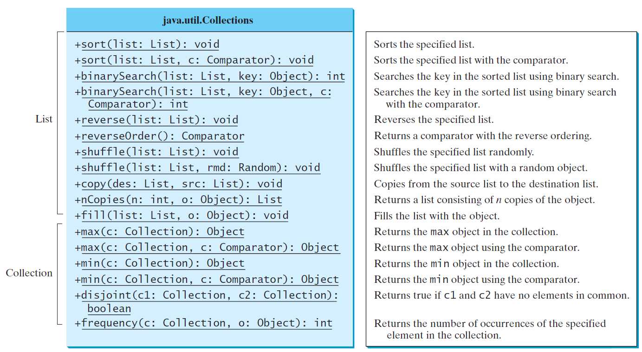
The Collections Class UML Diagram

Slide 41
The Vector and Stack Classes
The Java Collections Framework was introduced with Java 2. Several data structures were supported prior to Java 2. Among them are the Vector class and the Stack class. These classes were redesigned to fit into the Java Collections Framework, but their old-style methods are retained for compatibility. This section introduces the Vector class and the Stack class.

Slide 42
The Vector Class
The Vector class is replaced by the ArrayList.
Vector contains the synchronized methods for accessing and modifying the vector.
It is not efficient for most applications and is mostly unused now.
You may encounter Vector in the legacy Java code.

Slide 43
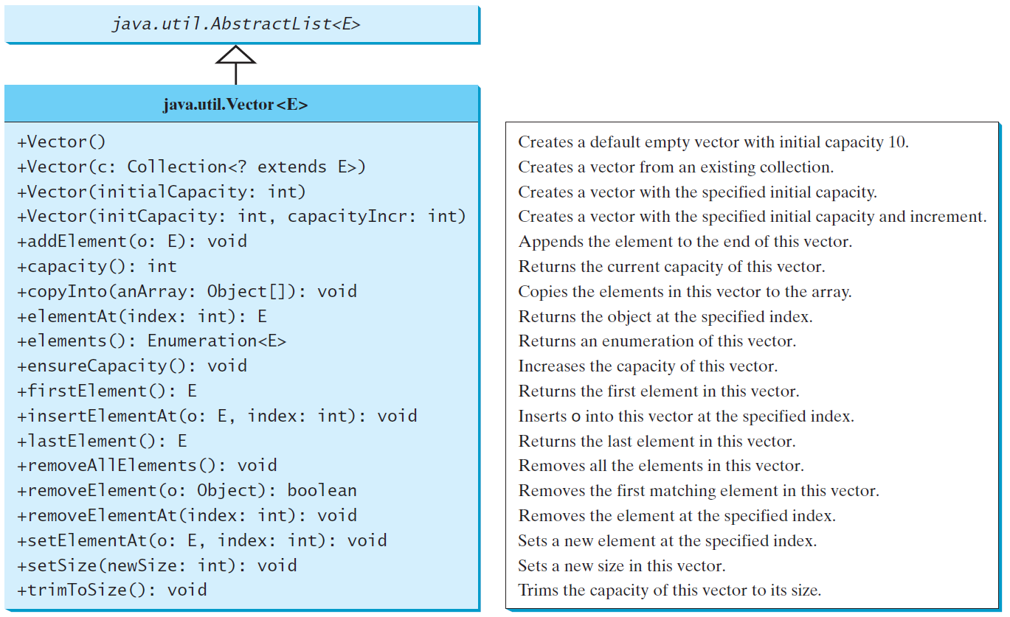
The Vector Class, cont.

Slide 44
The Stack Class
The Stack class represents a last-in-first-out stack of objects. The elements are accessed only from the top of the stack. You can retrieve, insert, or remove an element from the top of the stack.

Slide 45
The Stack Class
Use LIFO data ordering (Last In First Out): the last element added is the first to come off
Imagine a vertical stack of objects like a stack of plates
Items added and deleted from same end (the top/front)
Use push() to add, pop() to remove. Make sure you test for empty stack before using pop()
peek() method makes copy of first item but does not take it off
Easy way to reverse a collection of values
empty() is the method to see if a stack is empty
Top of stack
Item 1
Item 2
Item 3
Item 4
Null

Slide 46
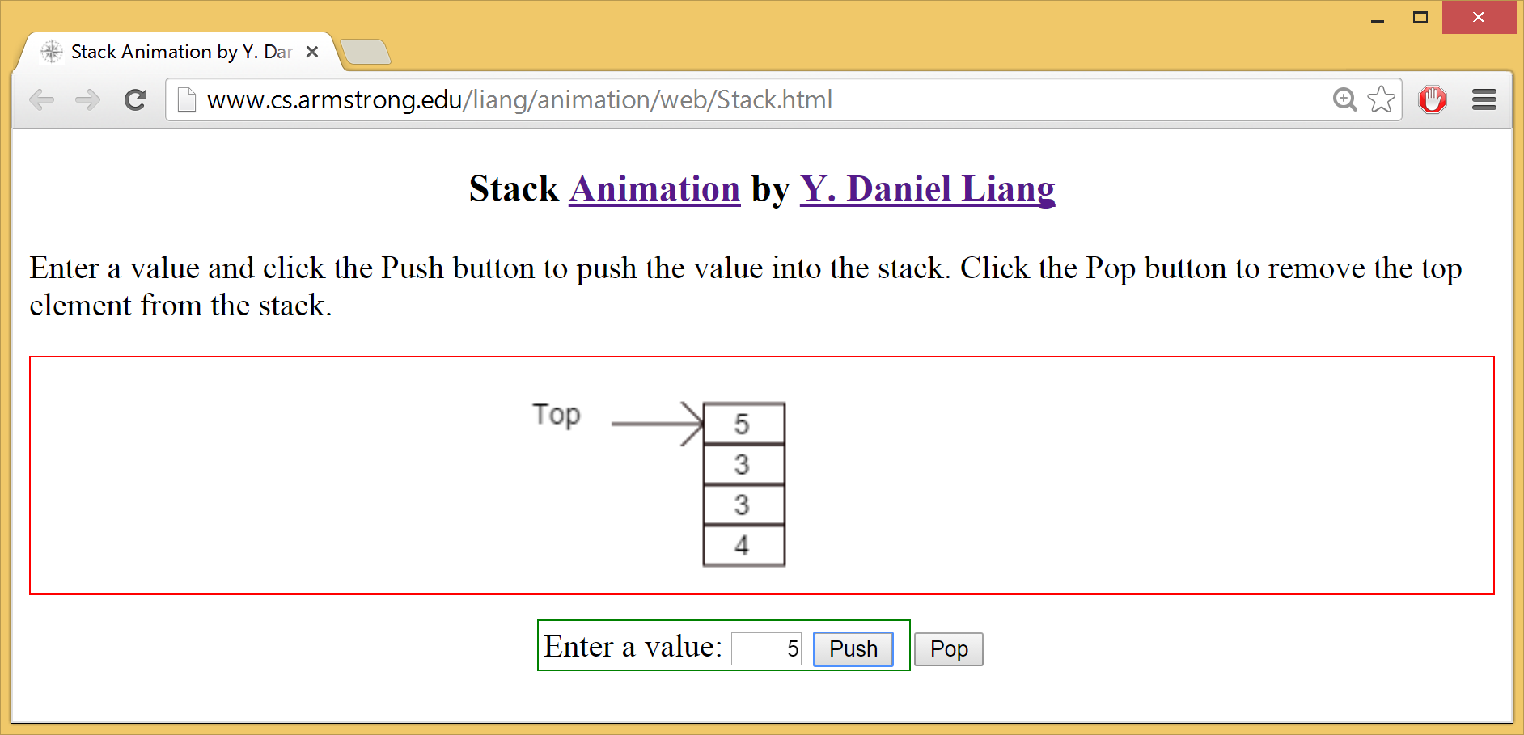
Stack Animation
https://liveexample.pearsoncmg.com/dsanimation/StackeBook.html

Slide 47
The Stack Class
BillStack
Imagine a basket with your bills for the month.
Electric bill Amount: 105.00
Due: 5/18/2021
Cell Phone Bill
Amount: 45.00
Due: 5/08/2021
Rent
Amount: 783.00
Due: 5/01/2021
Internet bill Amount: 53.00
Due: 5/15/2021
Need to use push() to add this to BillStack
Water bill Amount: 68.00
Due: 5/05/2021
Sample program: StackWithObjectDemo
Null

Slide 48
Queues and Priority Queues
A queue is a first-in/first-out (FIFO) data structure. (Created with a linked list)
Elements are added to the end of the queue and are removed from the beginning of the queue.
Think of people standing in line at the bank. They join at the end but exit from the front. (Print queue is another example.)
Methods:
  add(): add element at end
  peek() – returns copy of first element, but doesn’t remove it
  remove() – removes and returns first element
  poll() – removes & returns from the front & returns null if the queue is empty
  isEmpty() – returns true id the queue is empty & false otherwise
In a priority queue, elements are assigned priorities. When accessing elements, the element with the highest priority is removed first.
Example Animation

Slide 49
Queues and Priority Queues
import java.util.LinkedList;
import java.util.Queue;
public class QueueExample {
  public static void main(String[] args)
  {
    Queue<Integer> queue = new LinkedList<>();
    for(int i = 1;i<=10; i++)
      queue.add(i);
    System.out.println("Element in the queue: "+queue);
    int removed = queue.remove();
    System.out.println(removed + " was removed");
    int top = queue.peek();
    System.out.println("top element is: "+top);
    System.out.println(queue);
  }
}
Second example:
QueueDemoBankCustomers

Slide 50
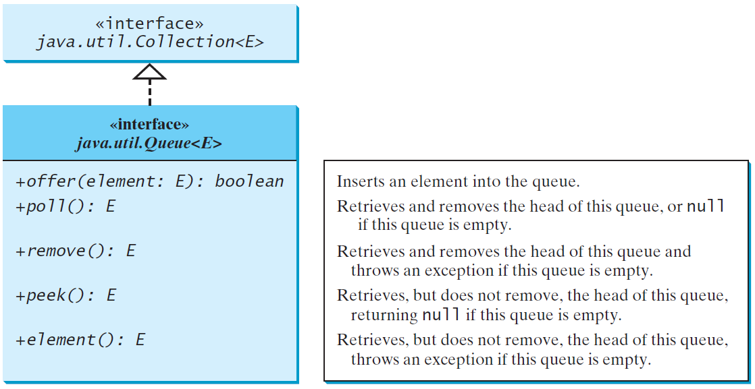
The Queue Interface

Slide 51
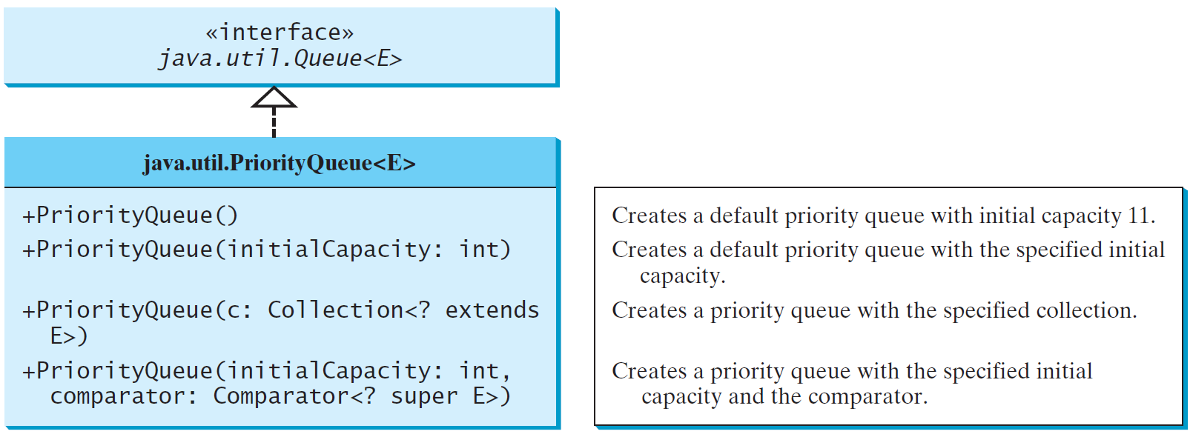
The PriorityQueue Class
PriorityQueueDemo

Slide 52
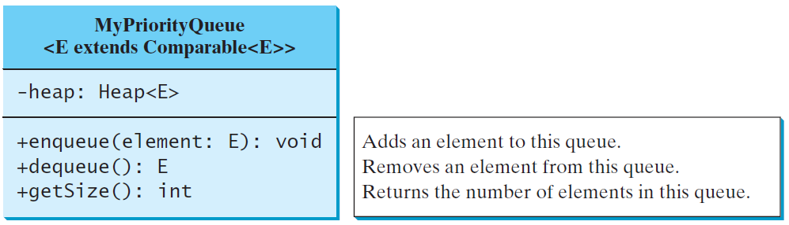
Priority Queue
A regular queue is a first-in and first-out data structure. Elements are appended to the end of the queue and are removed from the beginning of the queue. In a priority queue, elements are assigned with priorities. When accessing elements, the element with the highest priority is removed first. A priority queue has a largest-in, first-out behavior. For example, the emergency room in a hospital assigns patients with priority numbers; the patient with the highest priority is treated first.
MyPriorityQueue
TestPriorityQueue

Slide 53
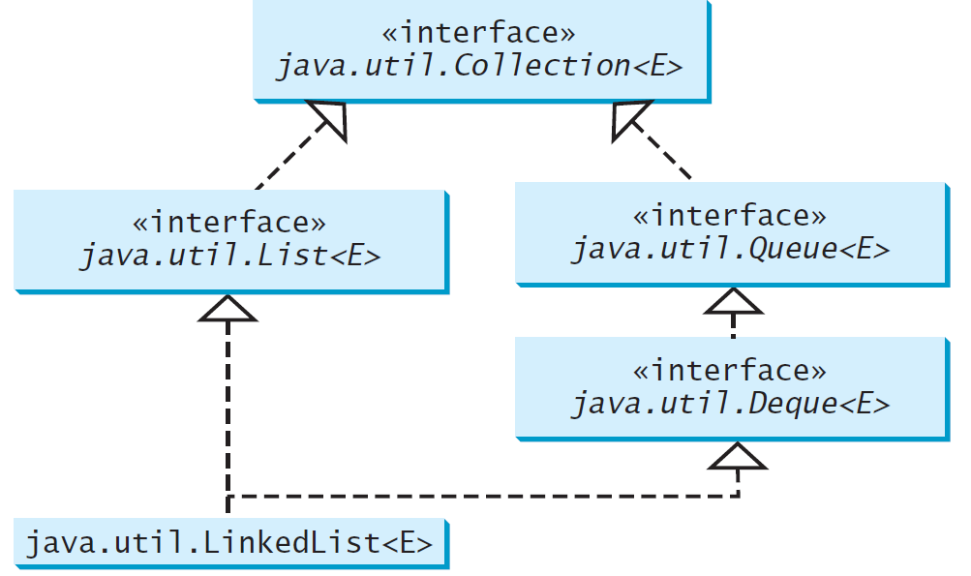
Using LinkedList for Queue

Slide 54
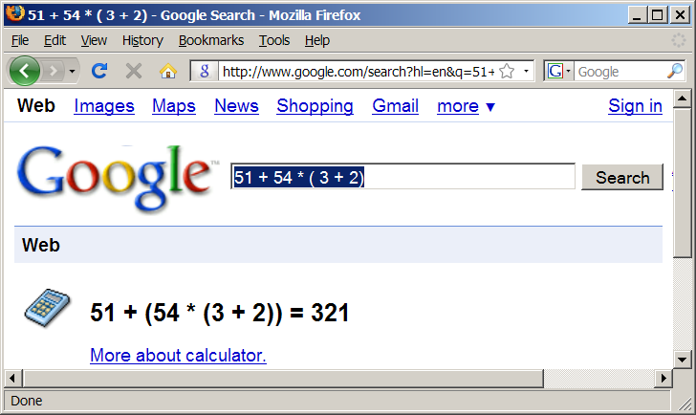
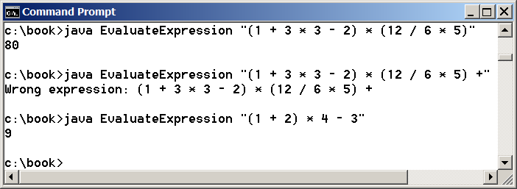
Case Study: Evaluating Expressions
Stacks can be used to evaluate expressions.
Evaluate Expression

Slide 55
Algorithm
Phase 1: Scanning the expression
The program scans the expression from left to right to extract operands, operators, and the parentheses.
1.1. If the extracted item is an operand, push it to operandStack.
1.2. If the extracted item is a + or - operator, process all the operators at the top of operatorStack and push the extracted operator to operatorStack.
1.3. If the extracted item is a * or / operator, process the * or / operators at the top of operatorStack and push the extracted operator to operatorStack.
1.4. If the extracted item is a ( symbol, push it to operatorStack.
1.5. If the extracted item is a ) symbol, repeatedly process the operators from the top of operatorStack until seeing the ( symbol on the stack.
Phase 2: Clearing the stack
Repeatedly process the operators from the top of operatorStack until operatorStack is empty.

Slide 56
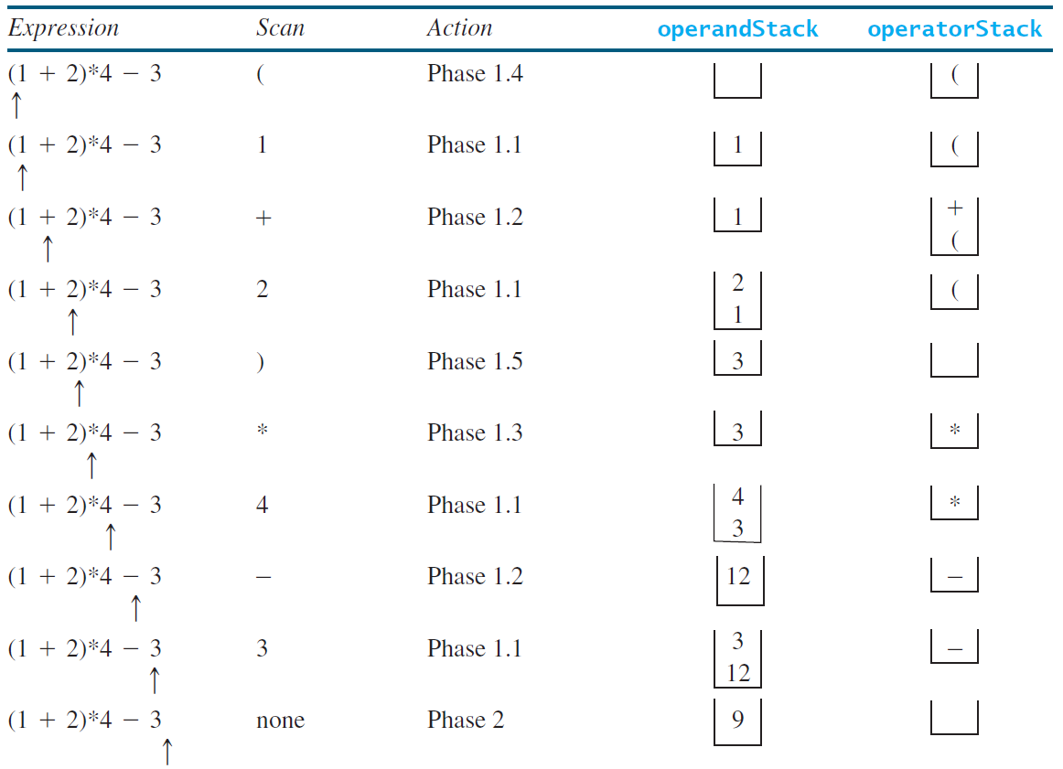
Example

